Slide 1
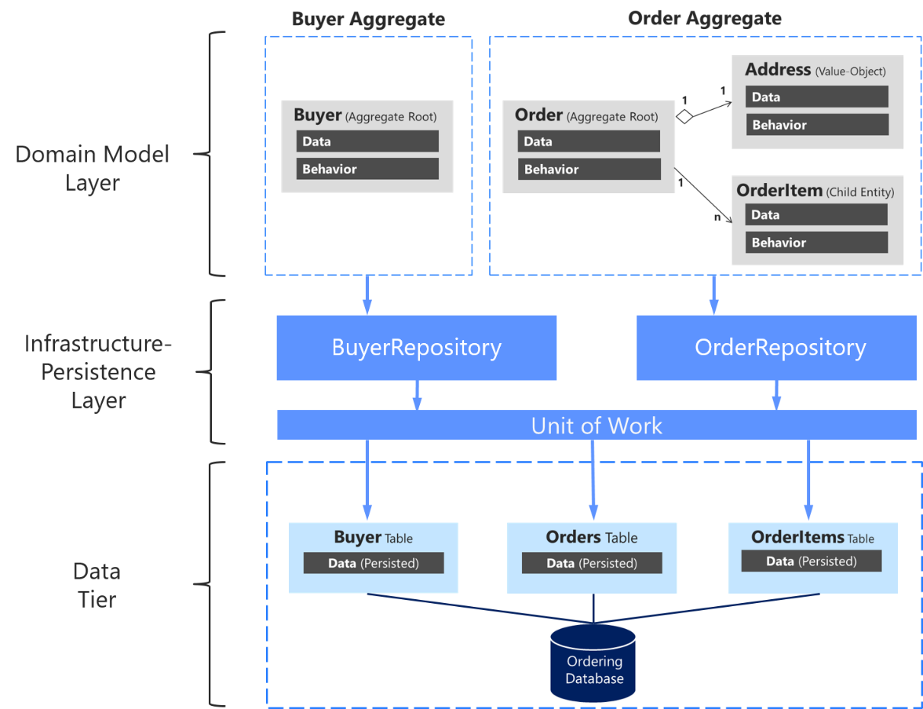
What is repository design pattern
The Repository pattern is a Domain-Driven Design pattern intended to keep
persistence concerns outside of the system's domain mode
What is the function of repository pattern?
The repository pattern is a design pattern that isolates the data layer from the rest of the app.
The data layer refers to the part of your app, separate from the UI, that handles the app's data and business logic, exposing consistent APIs for the rest of your app to access this data.

Slide 2
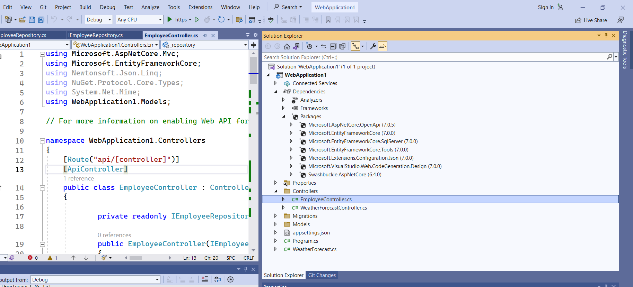
Down Load All dependency
MySql.Data.EntityFrameworkCore
If you want to use MySql database
Install-Package Microsoft.VisualStudio.Web.CodeGeneration.Design -Version 7.0.0
This package helps create database context and model classes from the database.
Install-Package Microsoft.EntityFrameworkCore.Tools -Version 7.0.0
Database provider allows Entity Framework Core to work with SQL Server.
Install-Package Microsoft.EntityFrameworkCore.SqlServer -Version 7.0.0
It provides support for creating and validating a JWT token.
Install-Package System.IdentityModel.Tokens.Jwt -Version 7.0.0
This is the middleware that enables an ASP.NET Core application to receive a bearer token in the request pipeline.
Install-Package Microsoft.AspNetCore.Authentication.JwtBearer -Version 7.0.0

Slide 3
namespace WebApplication1.Models
{
public class Employee
{
public int Id { get; set; }
public string? Name { get; set; }
public string? Email { get; set; }
public string? Department { get; set; }
}
}
namespace WebApplication1.Models
{
public interface IEmployeeRepository
{
Task<ActionResult<Employee>?> GetEmployee(int Id);
Task<ActionResult<IEnumerable<Employee>>> GetAllEmployee();
Task<ActionResult<Employee>> Add(Employee employee);
Task<Employee> Update(int id,Employee employeeChanges);
Task<Employee> Delete(int Id);
}
}
using System.Collections.Generic;
using Microsoft.EntityFrameworkCore;
namespace WebApplication1.Models
{
public class Appdbcontext: DbContext
{
public Appdbcontext(DbContextOptions<Appdbcontext> options)
: base(options)
{
}
protected override void OnConfiguring(DbContextOptionsBuilder optionsBuilder)
{
if (!optionsBuilder.IsConfigured)
{
optionsBuilder.UseSqlServer(@"Data Source=(localdb)\ProjectModels;Initial Catalog=DemoData;Integrated Security=True");
}
}
public DbSet<Employee> Employees { get; set; }
}
}
{
"Logging": {
"LogLevel": {
"Default": "Information",
"Microsoft.AspNetCore": "Warning"
}
},
"ConnectionStrings": {
"EmployeeDBConnection": "Data Source=(localdb)\\ProjectModels;Initial Catalog=DemoData;Integrated Security=True"
},
"AllowedHosts": "*"
}

Slide 4
namespace WebApplication1.Models
{
using Microsoft.AspNetCore.Mvc;
using Microsoft.EntityFrameworkCore;
using System.Collections.Generic;
public class SQLEmployeeRepository : IEmployeeRepository
{
private readonly Appdbcontext context;
public SQLEmployeeRepository(Appdbcontext context)
{
this.context = context;
}
public async Task<ActionResult<Employee>> Add(Employee employee)
{
context.Employees.Add(employee);
await context.SaveChangesAsync();
return employee;
}
public async Task<Employee> Delete(int Id)
{
Employee employee = context.Employees.Find(Id);
if (employee != null)
{
context.Employees.Remove(employee);
await context.SaveChangesAsync();
}
return employee;
}
public async Task<ActionResult<IEnumerable<Employee>?>> GetAllEmployee()
{
if (context.Employees == null)
{
return null;
}
return await context.Employees.ToListAsync();
}
public async Task<ActionResult<Employee>?> GetEmployee(int Id)
{
if (context.Employees == null)
{
return null;
}
var employee = await context.Employees.FindAsync(Id);
if (employee == null)
{
return null;
}
return employee;
}
public async Task<Employee?> Update(int id, Employee employee)
{
if (id != employee.Id)
{
return null;
}
context.Entry(employee).State = EntityState.Modified;
try
{
await context.SaveChangesAsync();
}
catch (DbUpdateConcurrencyException)
{
if (!EmployeeExists(id))
{
return null;
}
else
{
throw;
}
}
return null;
}
private bool EmployeeExists(int id)
{
return (context.Employees?.Any(e => e.Id == id)).GetValueOrDefault();
}
}
}

Slide 5
using Microsoft.AspNetCore.Mvc;
using Microsoft.EntityFrameworkCore;
using Newtonsoft.Json.Linq;
using NuGet.Protocol.Core.Types;
using System.Net.Mime;
using WebApplication1.Models;
// For more information on enabling Web API for empty projects, visit https://go.microsoft.com/fwlink/?LinkID=397860
namespace WebApplication1.Controllers
{
[Route("api/[controller]")]
[ApiController]
public class EmployeeController : ControllerBase
{
private readonly IEmployeeRepository _repository;
public EmployeeController(IEmployeeRepository repository)
{
_repository = repository;
}
[HttpGet]
public async Task<ActionResult<IEnumerable<Employee>?>> GetEmployees()
{
if (await _repository.GetAllEmployee() == null)
{
return NotFound();
}
return await _repository.GetAllEmployee();
}
[HttpGet("{id}")]
public async Task<ActionResult<Employee>> GetById_ActionResultOfT(int id)
{
var employee = await _repository.GetEmployee(id);
return employee == null ? NotFound() : employee;
}
// PUT: api/Employees/5
// To protect from overposting attacks, see https://go.microsoft.com/fwlink/?linkid=2123754
[HttpPut("{id}")]
public async Task<IActionResult> PutEmployee(int id, Employee employee)
{
if (id != employee.Id)
{
return BadRequest();
}
try
{
await _repository.Update(id,employee);
}
catch (DbUpdateConcurrencyException)
{
if (_repository.GetEmployee(id)==null)
{
return NotFound();
}
else
{
throw;
}
}
return NoContent();
}
// POST: api/Employees
// To protect from overposting attacks, see https://go.microsoft.com/fwlink/?linkid=2123754
[HttpPost]
public async Task<ActionResult<Employee>> PostEmployee(Employee employee)
{
await _repository.Add(employee);
return CreatedAtAction("GetById_ActionResultOfT", new { id = employee.Id }, employee);
}
// DELETE: api/Employees/5
[HttpDelete("{id}")]
public async Task<IActionResult> DeleteEmployee(int id)
{
await _repository.Delete(id);
return NoContent();
}
}
}

Slide 6
using Microsoft.EntityFrameworkCore;
using Microsoft.Extensions.Options;
using WebApplication1.Models;
namespace WebApplication1
{
public class Program
{
public static void Main(string[] args)
{
var builder = WebApplication.CreateBuilder(args);
// Add services to the container.
builder.Services.AddControllers();
builder.Services.AddTransient<IEmployeeRepository, SQLEmployeeRepository>();
builder.Services.AddDbContext<AppContext>(option => option.UseSqlServer(builder.Configuration.GetConnectionString("EmployeeDBConnection")));
// Learn more about configuring Swagger/OpenAPI at https://aka.ms/aspnetcore/swashbuckle
builder.Services.AddEndpointsApiExplorer();
builder.Services.AddSwaggerGen();
var app = builder.Build();
// Configure the HTTP request pipeline.
if (app.Environment.IsDevelopment())
{
app.UseSwagger();
app.UseSwaggerUI();
}
app.UseHttpsRedirection();
app.UseAuthentication();
app.UseAuthorization();
app.MapControllers();
app.Run();
}
}
}

Slide 7
using Microsoft.AspNetCore.Authentication.JwtBearer;
using Microsoft.EntityFrameworkCore;
using Microsoft.Extensions.Options;
using Microsoft.IdentityModel.Tokens;
using System.Text;
using WebApplication1.Models;
namespace WebApplication1
{
public class Program
{
public static void Main(string[] args)
{
var builder = WebApplication.CreateBuilder(args);
// Add services to the container.
builder.Services.AddControllers();
builder.Services.AddTransient<IEmployeeRepository, SQLEmployeeRepository>();
builder.Services.AddDbContext<Appdbcontext>(option => option.UseSqlServer(builder.Configuration.GetConnectionString("EmployeeDBConnection")));
// Learn more about configuring Swagger/OpenAPI at https://aka.ms/aspnetcore/swashbuckle
builder.Services.AddEndpointsApiExplorer();
builder.Services.AddCors(options =>
{
options.AddPolicy("MyAllowSpecificOrigins",
builder =>
{
builder.WithOrigins("http://127.0.0.1:5500") .AllowAnyHeader() .AllowAnyMethod();
});
}) ;
builder.Services.AddSwaggerGen();
var app = builder.Build();
// Configure the HTTP request pipeline.
if (app.Environment.IsDevelopment())
{
app.UseSwagger();
app.UseSwaggerUI();
}
app.UseHttpsRedirection();
app.UseAuthentication();
app.UseAuthorization();
app.UseCors("MyAllowSpecificOrigins");
app.MapControllers();
app.Run();
}
}
}
How to enable cores

Slide 8
D:\DOT NET\50DotNetCore\coreWebAPI\webapiAuthenticationdemo\WebApplication1\WebApplication1

Slide 9
Creates an Microsoft.AspNetCore.Mvc.NotFoundResult that produces a Microsoft.AspNetCore.Http.StatusCodes.Status
404 NotFound
NotFound();
BadRequest();
Creates an Microsoft.AspNetCore.Mvc.BadRequestResult that produces a Microsoft.AspNetCore.Http.StatusCodes.Status
400 BadRequest
Creates a Microsoft.AspNetCore.Mvc.NoContentResult object that produces an empty
// Microsoft.AspNetCore.Http.StatusCodes.Status
204 NoContent.
NoContent();
Creates a Microsoft.AspNetCore.Mvc.CreatedAtActionResult object that produces
// a Microsoft.AspNetCore.Http.StatusCodes.Status
201 Created response.
CreatedAtAction("PostEmployee", new { id = employee.Id }, employee);
// Summary:
// Creates a Microsoft.AspNetCore.Mvc.CreatedAtActionResult object that produces
// a Microsoft.AspNetCore.Http.StatusCodes.Status201Created response.
//
// Parameters: // actionName:
// The name of the action to use for generating the URL.
//
// routeValues: // The route data to use for generating the URL.
//
// value: // The content value to format in the entity body.
//
// Returns: // The created Microsoft.AspNetCore.Mvc.CreatedAtActionResult for the response.

Slide 10
The ActionResult types represent various HTTP status codes. Any non-abstract class deriving from ActionResult qualifies as a valid return type. Some common return types in this category are BadRequestResult (400),
NotFoundResult (404), and
OkObjectResult (200).
Alternatively, convenience methods in the ControllerBase class can be used to return ActionResult types from an action. For example, return BadRequest(); is a shorthand form of return new BadRequestResult();.
Because there are multiple return types and paths in this type of action, liberal use of the [ProducesResponseType] attribute is necessary.
This attribute produces more descriptive response details for web API help pages generated by tools like Swagger. [ProducesResponseType] indicates the known types and HTTP status codes to be returned by the action.
The most basic action returns a primitive or complex data type, for example, string or a custom object. Consider the following action, which returns a collection of custom Product objects:
C#
[HttpGet]
public Task<List<Product>> Get() =>
_productContext.Products.OrderBy(p => p.Name).ToListAsync();
Without known conditions to safeguard against, returning a specific type could suffice. The preceding action accepts no parameters, so parameter constraints validation isn't needed.
When multiple return types are possible, it's common to mix an ActionResult return type with the primitive or complex return type. Either IActionResult or ActionResult<T> are necessary to accommodate this type of action.
https://learn.microsoft.com/en-us/aspnet/core/web-api/action-return-types?view=aspnetcore-7.0

Slide 11
[HttpPost]
[ProducesResponseType(StatusCodes.Status201Created)]
[ProducesResponseType(StatusCodes.Status400BadRequest)]
public ActionResult<Pet> Create(Pet pet)
{
pet.Id = _petsInMemoryStore.Any() ?
_petsInMemoryStore.Max(p => p.Id) + 1 : 1;
_petsInMemoryStore.Add(pet);
return CreatedAtAction(nameof(GetById), new { id = pet.Id }, pet);
}

Slide 12
Update explanation
If id in url and id in employee object does not match then it will return null
public async Task<Employee?> Update(int id, Employee employee)
{
if (id != employee.Id)
{
return null;
}
context.Entry(employee).State = EntityState.Modified;
try
{
await context.SaveChangesAsync();
}
catch (DbUpdateConcurrencyException)
{
if (!EmployeeExists(id))
{
return null;
}
else
{
throw;
}
}
return null;
}
private bool EmployeeExists(int id)
{
return (context.Employees?.Any(e => e.Id == id)).GetValueOrDefault();
//if id is there it will return true and if its not there it will return null and
GetValueOrDefault() method will return true if id is there else
it will return default value false.
}
If you try to update a id which is not there in database it will throw DbUpdateConcurrencyException
The database operation was expected to affect 1 row(s), but actually affected 0 row(s); data may have been modified or deleted since entities were loaded.

Slide 13
ControllerBase Class
The ControllerBase class is a base class for controllers in ASP.NET Core. It provides basic functionality for handling HTTP requests and responses, but does not include any MVC-specific features such as action filters or view rendering.
Controller Class
The Controller class is a part of the System.Web.Mvc namespace and is used to create controllers for ASP.NET MVC applications. It is the base class for all controllers in MVC and provides a wide range of features and functionalities such as action filters, model binding, and view rendering.
using System.Web.Mvc;
public class HomeController : Controller
{
public ActionResult Index()
{
return View();
}
}
APIController Class
The APIController class is also a part of the Microsoft.AspNetCore.Mvc namespace and is used to create controllers for ASP.NET Core Web API applications. It is a specialized version of the ControllerBase class and includes features specific to Web API development such as content negotiation and routing.
using Microsoft.AspNetCore.Mvc;
[ApiController]
[Route("[controller]")]
public class WeatherForecastController : ControllerBase
{
[HttpGet]
public IEnumerable<WeatherForecast> Get()
{
// Code to get weather forecast data
}
}
using Microsoft.AspNetCore.Mvc;
public class HomeController : ControllerBase
{
[HttpGet]
public IActionResult Index()
{
return Ok();
}
}

